Slide 1

Data Description
Session 4
M. Kachour

Slide 2
Exercise 1
We studied the morning temperature (i.e. measured between 7am and 7.30am) over 200 days chosen randomly from the winter periods observed over the last 20 years.
The data are represented in the following table:
Study the existence of outliers
Temperature | Number of days
-1 | 40
0 | 34
2 | 86
3 | 20
7 | 20

Slide 3
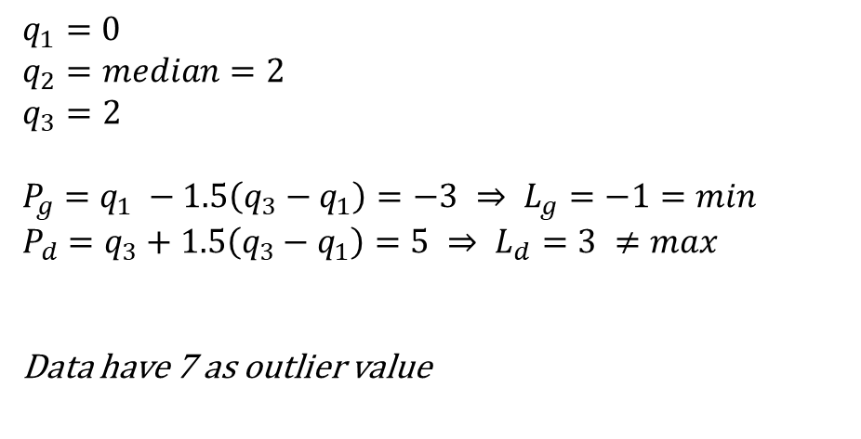
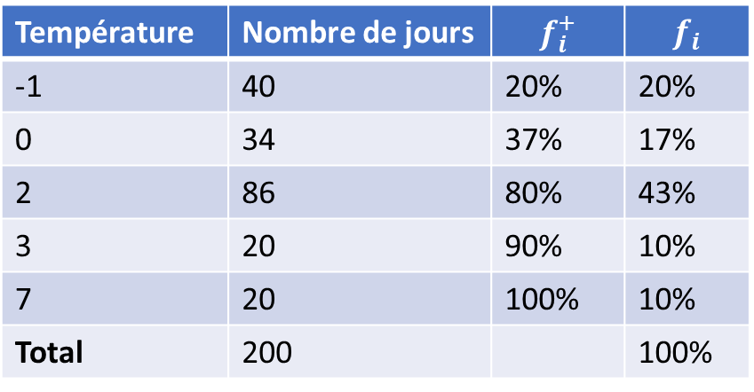
Exercise 1 - Solution
Temperature | Number of days | $$f_{i}^{+}$$ | $$f_{i}$$
-1 | 40 | 20% | 20%
0 | 34 | 37% | 17%
2 | 86 | 80% | 43%
3 | 20 | 90% | 10%
7 | 20 | 100% | 10%
Total | 200 |  | 100%
$$q_{1}=0$$
$$q_{2}=median=2$$
$$q_{3}=2$$
$$P_{g}=q_{1} −1.5\left(q_{3}−{ q}_{1}\right)=−3 ⇒ L_{g}=−1=min$$
$$P_{d}=q_{3}+1.5\left(q_{3}−{ q}_{1}\right)=5 ⇒ L_{d}=3 ≠max$$
Data have 7 as outlier value

Slide 4
Exercise 2
We studied the morning speed (i.e. measured (in Km/h) between 7am and 7.30am) of the wind over
240 days chosen randomly from the winter periods observed over the last 20 years.
The data are represented in the following table:
Study the existence of outliers
Speed | Number of days
[0 ; 10[ | 42
[10 ; 30[ | 48
[30 ; 70[ | 90
[70 ; 100[ | 24
[100 ; 150[ | 36

Slide 5


Exercise 2 - Solution
Speed | $$f_{i}^{+}$$ | $$f_{i}$$
[0 ; 10[ | 17.5% | 17.5%
[10 ; 30[ | 37.5% | 20%
[30 ; 70[ | 75% | 37.5%
[70 ; 100[ | 85% | 10%
[100 ; 150[ | 100% | 15%
Total |  | 100%
$$q_{1}=10+\left(30 −10\right)× \frac{(0.25 −0.175)}{(0.375 −0.175)}=17.5$$
$$q_{2}=median=30+\left(70 −30\right)× \frac{(0.5 −0.375)}{(0.75 −0.375)}≈43.33$$
$$q_{3}=70+\left(100 −70\right)× \frac{(0.75 −0.75)}{(0.85 −0.75)}=70$$
$$P_{g}=q_{1} −1.5\left(q_{3}−{ q}_{1}\right)=−61.25⇒ L_{g}=0=min$$
$$P_{d}=q_{3}+1.5\left(q_{3}−{ q}_{1}\right)=148.75⇒ L_{d}=100 ≠max$$
The class [100, 150[ is considered as outlier

